Slide 1
Final Project Presentation
General Assembly
Elaine Cao

Slide 2
PresentationOutline
I. Introduction
II. Exploratory Data Analysis
III. Modeling Process
IV. Modelings Results
V. Conclusions/Further Work

Slide 3

Introduction
Problem
Nearly half of Americans are considered obese or overweight
US obese population is higher than any where else in the world
Machine Learning Objective
Predict population obesity rate based on household income level, fruit consumption, and vegetable consumption
Target: Obesity %
Input Variables: Income Level, % No Fruit, % No Vegetables
Background
Why?
Project chosen because there needs to be better products and services in the market place to promote healthier eating habits
Data
Center for Disease Control and Prevention
Monitoring system for every US state from 2011 to 2016
Data grouped by income level

Slide 4
Exploratory Data Analysis (EDA)
Of the input variables obesity rate is most correlated with income level (positive).
Obesity rate and income are negatively correlated with no/low physical activity and fruit & vegetable consumption

Slide 5
Exploratory Data Analysis (EDA)
Obesity rates captured in the data set have low variability (CV = .08)
The Mean obesity rate is 36.35. Standard deviation is 3.08.

Slide 6
Exploratory Data Analysis (EDA)
Population in the sample data set has high rates of low fruit consumption vs vegetable in take or physical activity.

Slide 7
Exploratory Data Analysis (EDA)
Obesity rate appears to increase with higher income levels, especially above $25K.

Slide 8
Modeling Process / Results
Linear Regression model produced the highest R2 (34%).
This is a low R-squared which means the model unfortunately does not do a good job of capturing the data.
Data Cleaning
Linear Regression
K-Nearest Neighbor
Decision Tree
Random Forest
Grouped data by US State, year and income range
1340 original rows, 810 dropped
Re-labeled income ranges
Created target and input variables (3) – metric R2
70/30 Train Test Split
Test R2 34%
Train R2 29%
Optimal Neighbors 27
Cross Validated R2 30%
Optimal Max Depth 3
Cross validated R2 25%
Optimal Estimators 40
Cross Validated R2 23%

Slide 9
Modeling Process / Results
In order to better understand important features, below is a deeper look at the decision tree model.
Income is the most important feature followed by low vegetable intake and no physical activity
No
Predicted Obesity Rate = 34%
Income > $30K?
Yes
Predicted Obesity Rate = 37%
Low Vegetable Consumption > 28%?
Income > $62.5K
No
Predicted Obesity Rate = 35%
Yes
Predicted Obesity Rate = 33%
No
Predicted Obesity Rate = 37%
Yes
Predicted Obesity Rate = 38%
Income > $20K
Low Vegetable Consumption > 38%?
Low Vegetable Consumption > 26%?
No Physical Activity > 10%?
Yes
Predicted Obesity Rate = 36%
Yes
Predicted Obesity Rate = 29%
Yes
Predicted Obesity Rate = 35%
Yes
Predicted Obesity Rate = 38%
No
Predicted Obesity Rate = 34%
No
Predicted Obesity Rate = 33%
No
Predicted Obesity Rate = 37%
No
Predicted Obesity Rate = 33%
Higher low vegetable consumption yield lower obesity rates?
Important Features: {'Income’ 0.8009683478378447, 'Low_Vegetables' 0.1667205411711661, 'No_Physical_Activity' 0.03231111099098933, 'Low_Fruit' 0.0}

Slide 10
Conclusion and Further Work
Income, vegetable consumption, and physical activity are important factors in predicting obesity rate.
Higher income levels correspond to higher obesity. This demographic should be a consideration in efforts to promote healthier eating habits.
My original hypothesis was not correct. I assumed that the higher income level population would have lower the obesity rate (less junk food, more educated?). Additionally, I was surprised low fruit consumption in the US overall (minimal role in predicting obesity).
Further areas for investigation:
Trends in obesity by State
Trends in obesity over time (2011-2016)
Vegetable consumption in relationship obesity (deeper dive)
Education data in relationship to obesity (additional data set)

Slide 11
Questions??

Slide 12
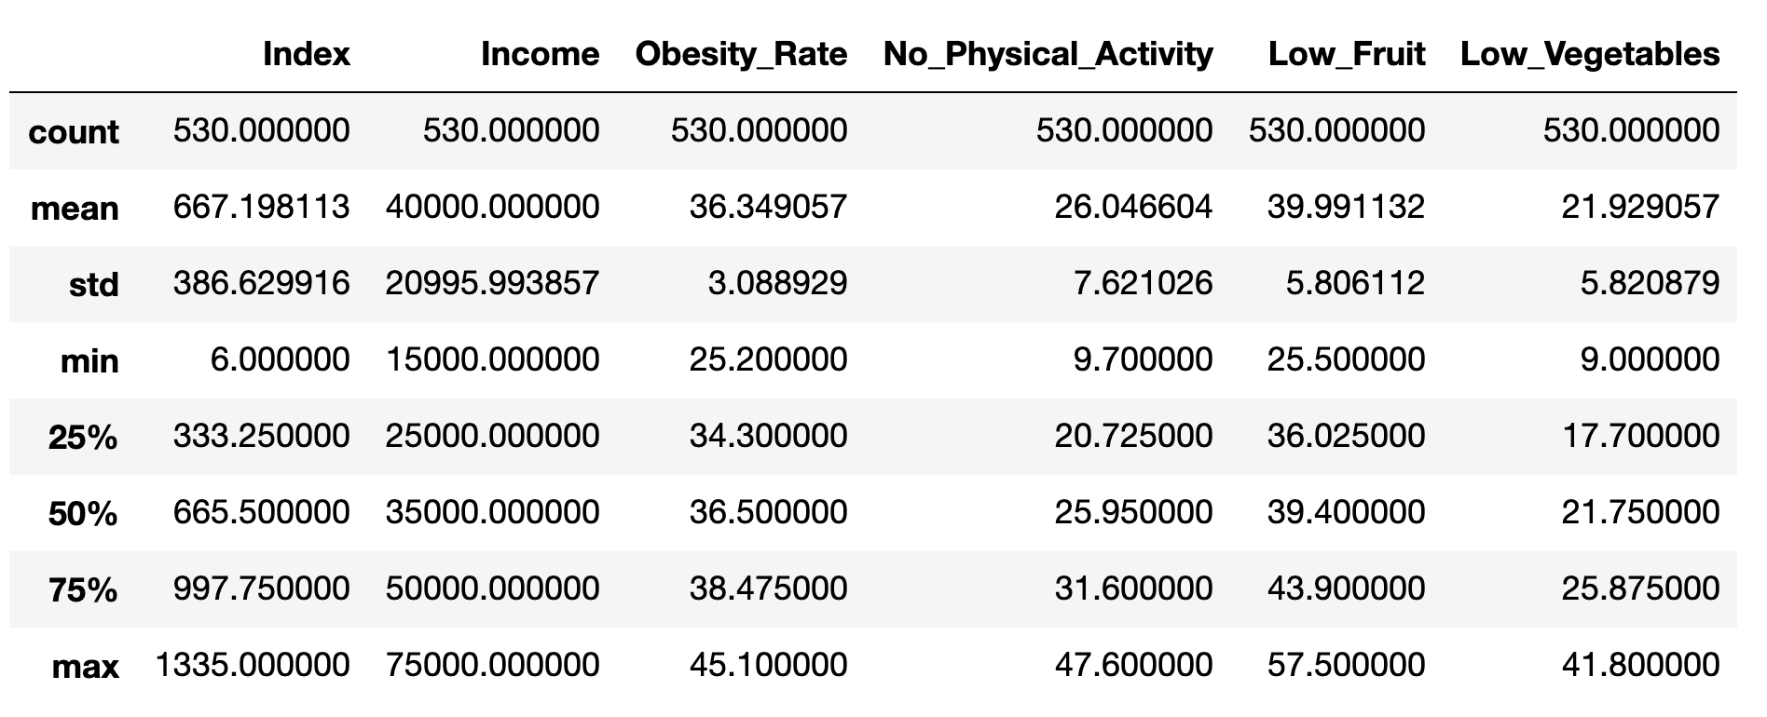
Appendix
General Statistics

Slide 13
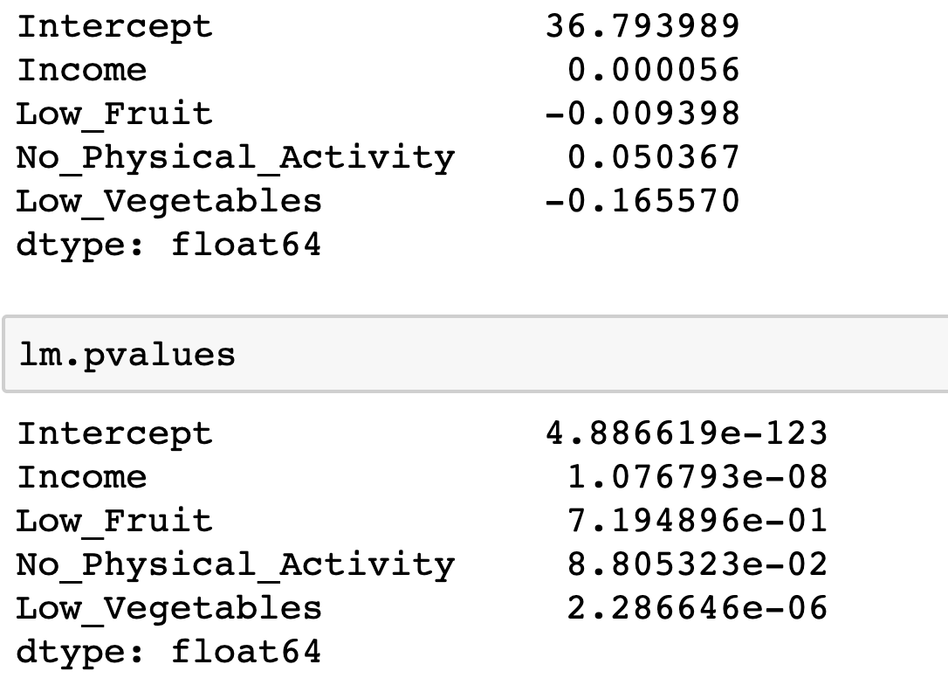
Appendix
Linear Regression Model
70/30 Train Test Split
Test R2 34%
Train R2 29%

Slide 14
Appendix
K-Nearest Neighbors Model

Slide 15
Appendix
Decision Tree Model

Slide 16
Appendix
Decision Tree Model

Slide 17
Appendix
Random Forest Model

